Slide 1
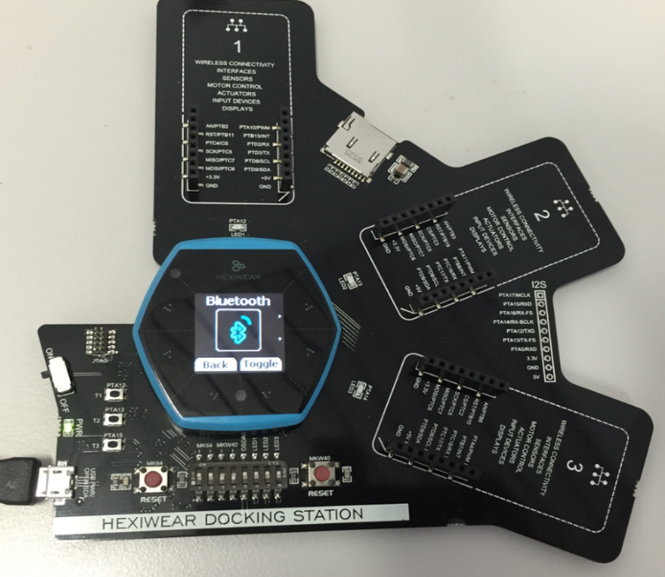
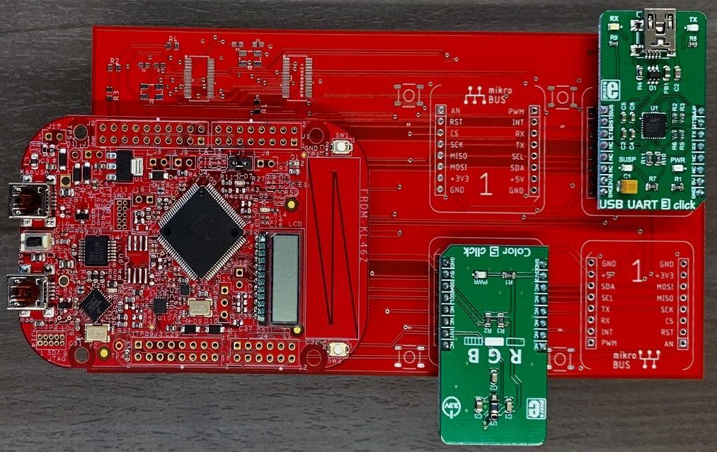

CLICK SENSOR HUB
THE TEAM:
ALFONSO DE LA MORENA <PM>, DYLAN DEAN, MOHAMED SGHARI
SPONSOR: DR KEVIN KEMP <NXP>
FACULTY ADVISOR: DR WILLIAM STAPLETON

Slide 2
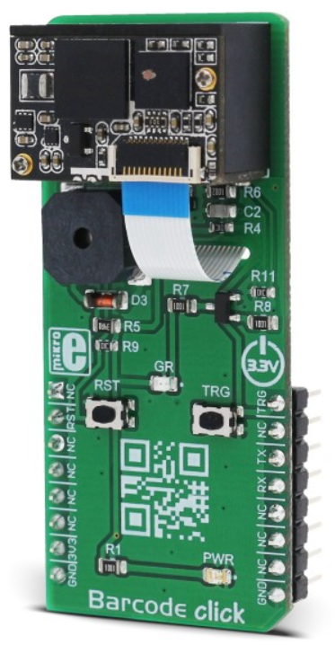
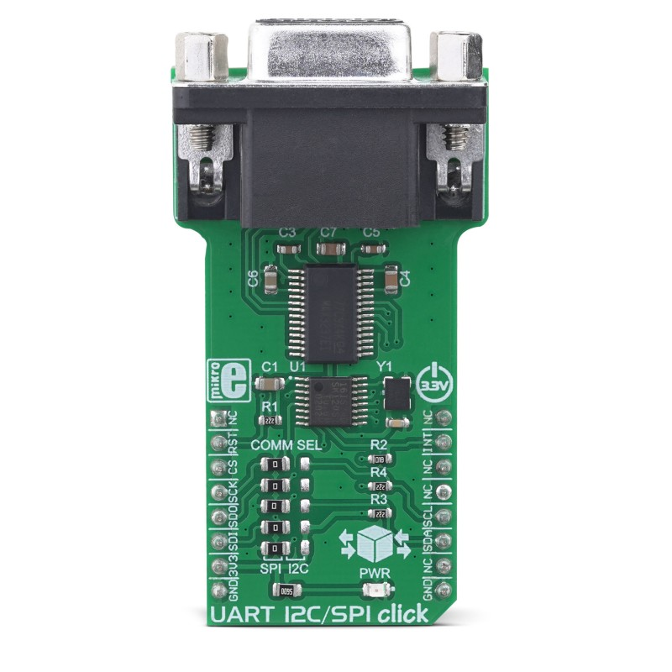
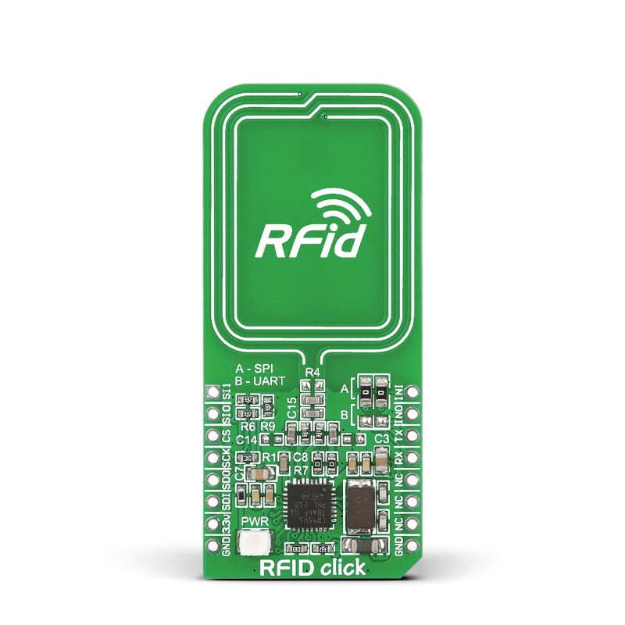
What are Clicks?
Click boards are plug-and-play modules designed to add extra functionality to existing development kits. These small, function-specific add-on boards/modules all have a common interface to the mikroBUS; adapter board.

Slide 3



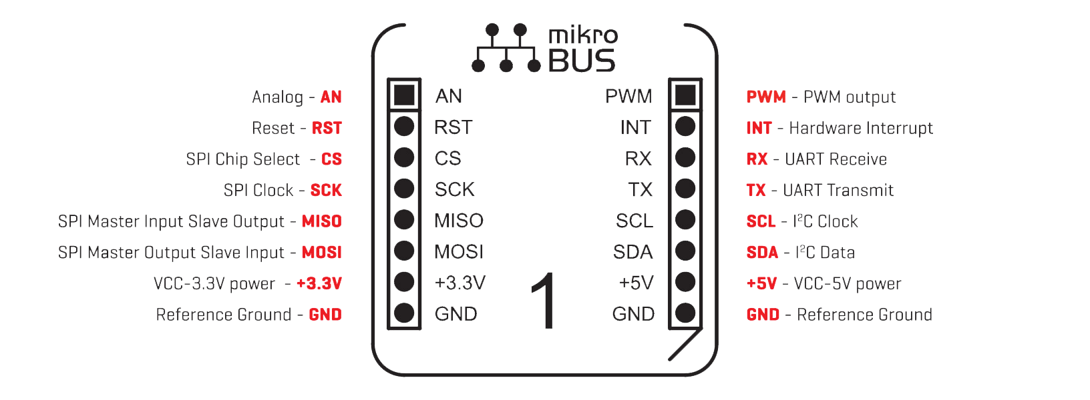
Why use Clicks?
Major chip vendors are endorsing it
It's an open standard
mikroBUS™ - the add-on board standard that offers maximum expandability with the smallest number of pins. Integrate it into your design and open the doors of thousands of possibilities.

Slide 4
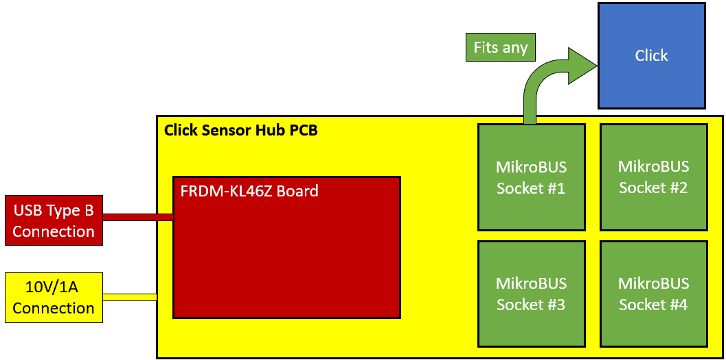
What is the Click Sensor Hub?
# | Project Requirements
1 | PCB that connects FRDM-KL46Z to 4 mikroBUS Sockets
2 | Each of the 4 sockets receive 5V and 3.3V channels
3 | Each of the 4 sockets must communicate with SPI, UART, PWM, I2C and Analog
4 | Write code to test at least 10 Clicks on the Board

Slide 5
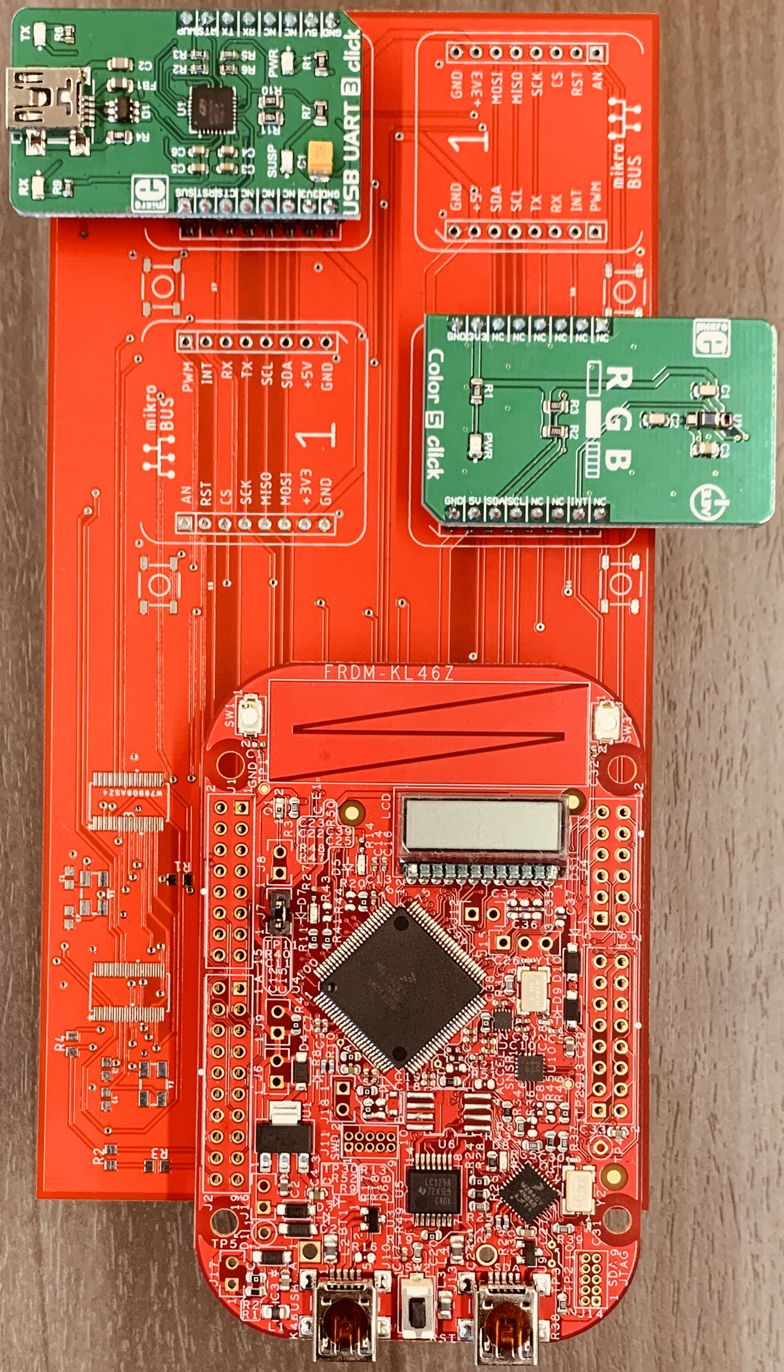
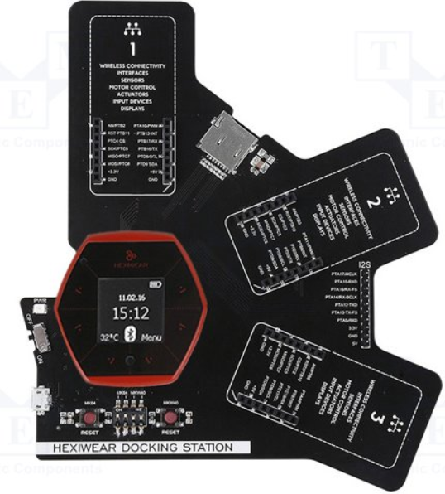
Project Motivation
NXP Hexiwear:
Hexiwear Docking Station
NXP FRDM-KL46Z Board:
Click Sensor Hub
Notes:
Why did we start this project? An attempt to Improve and expand upon current click SHIELD, and provide the microprocessors course at Texas State with an IoT development kit.

Slide 6
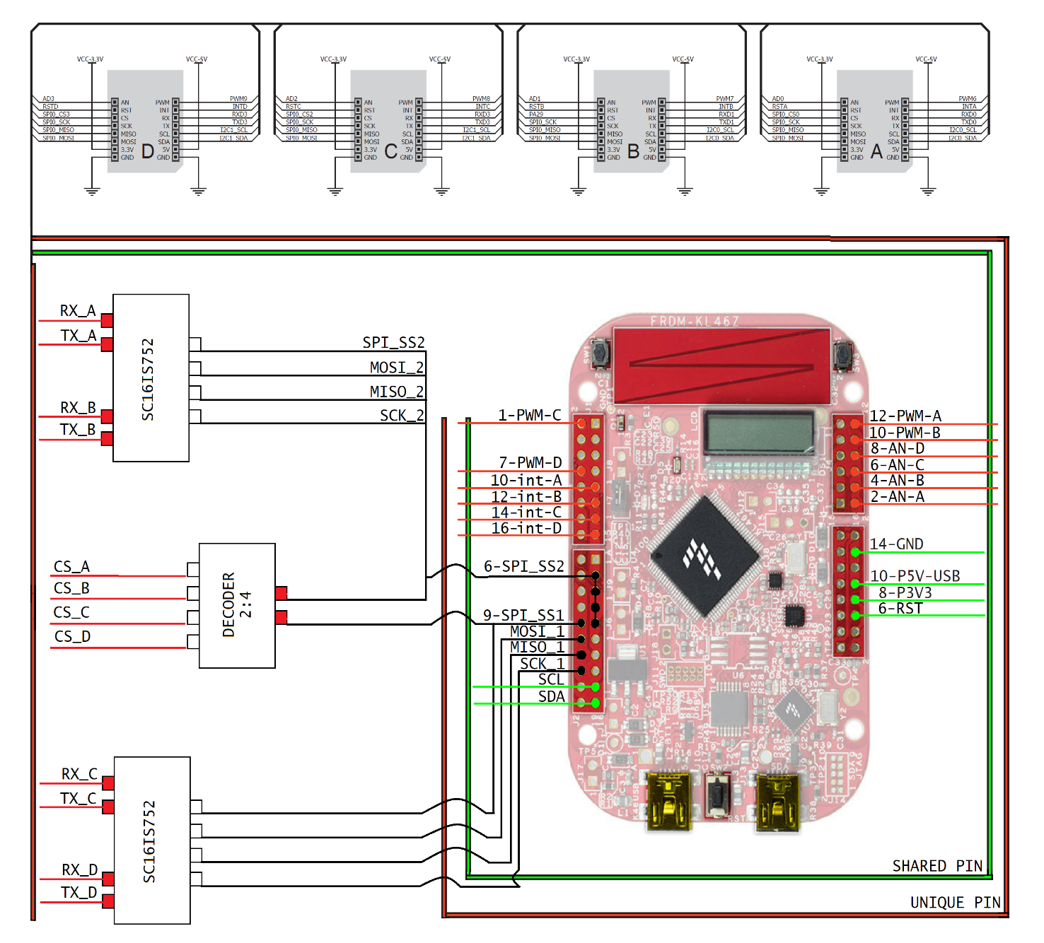
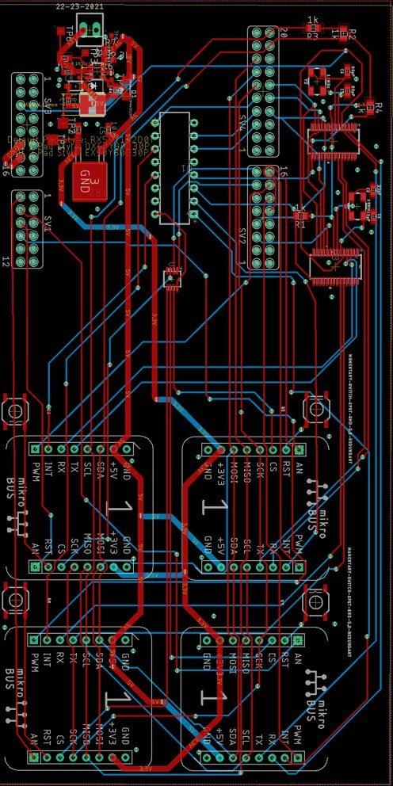

Hardware Approach

Slide 7
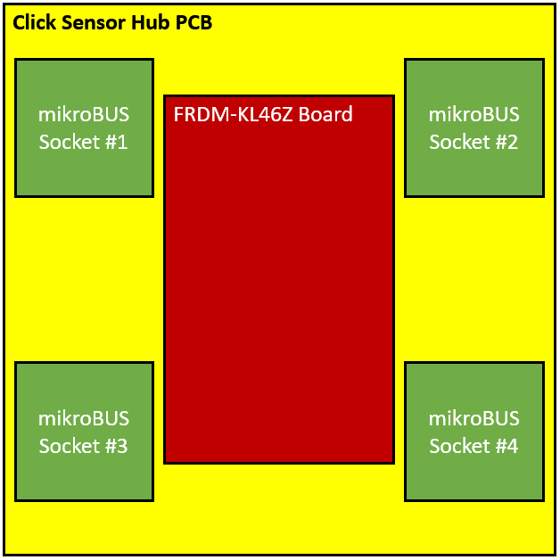
Hardware – First Board Design
Pros
More space for clicks
Cons
Complicated wiring
Cost more

Slide 8
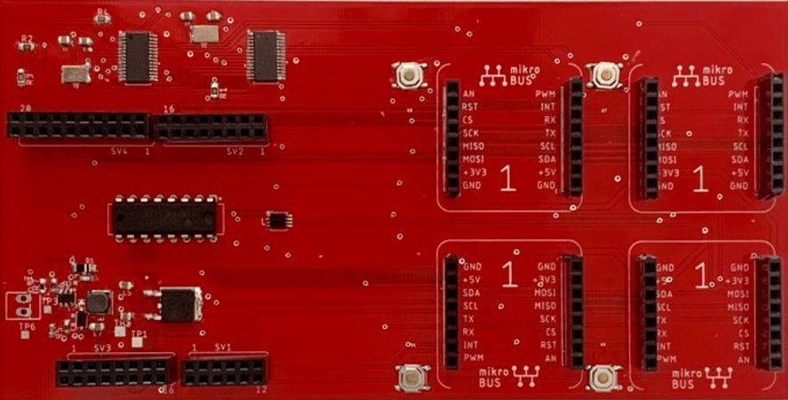
Hardware – Second Board Design
Pros
Smaller board size
Shorter wire connection
Four Sockets all have SPI, UART, I2C, PWM and Analog
Cons
Soldering ICs difficult with available equipment

Slide 9
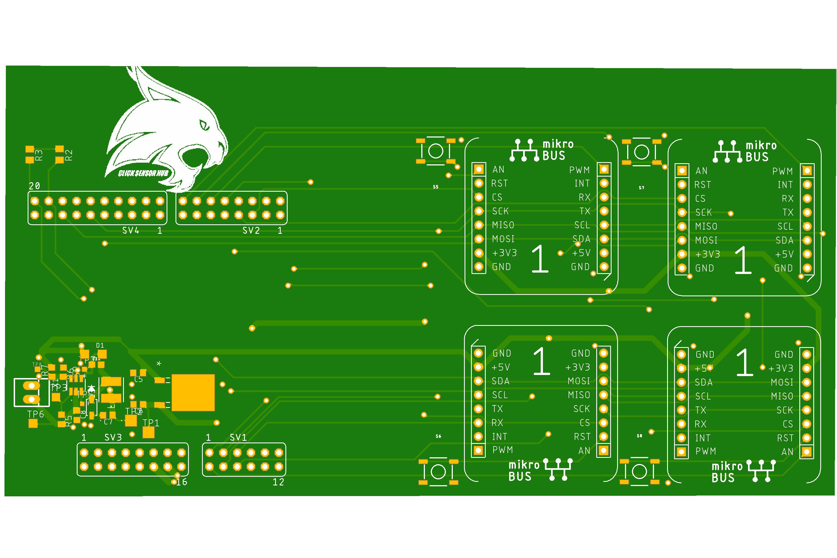
Hardware – Third Board Design
Pros
Cost less
Easier to code
Cons
Only one Socket has UART protocol connection

Slide 10
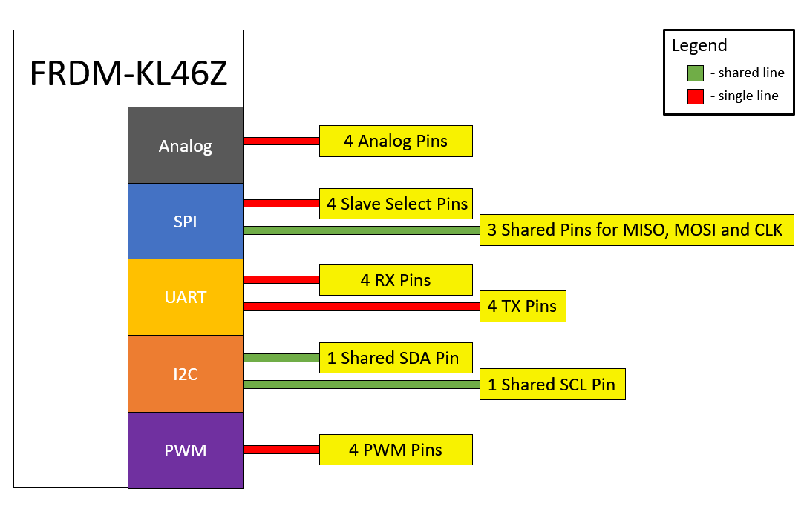

Software Approach

Slide 11
How to deal with multiple sockets

Slide 12
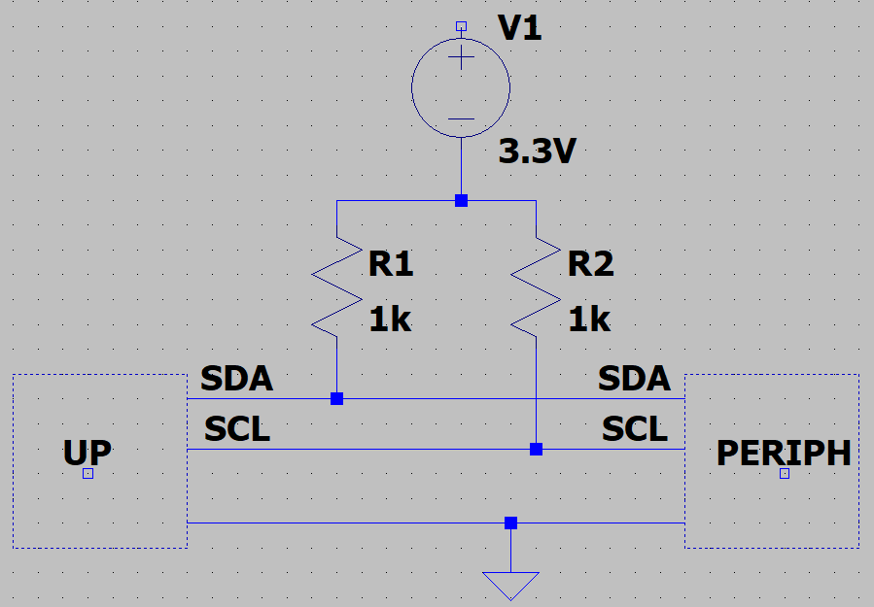
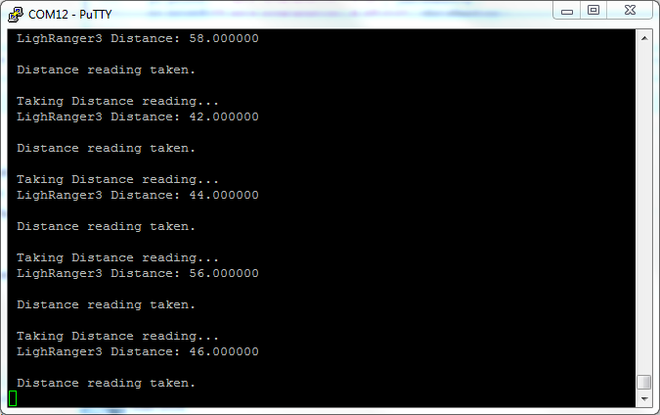
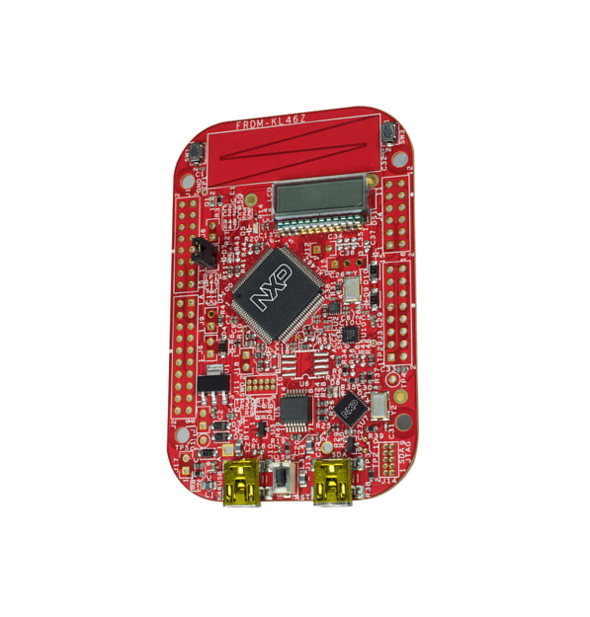
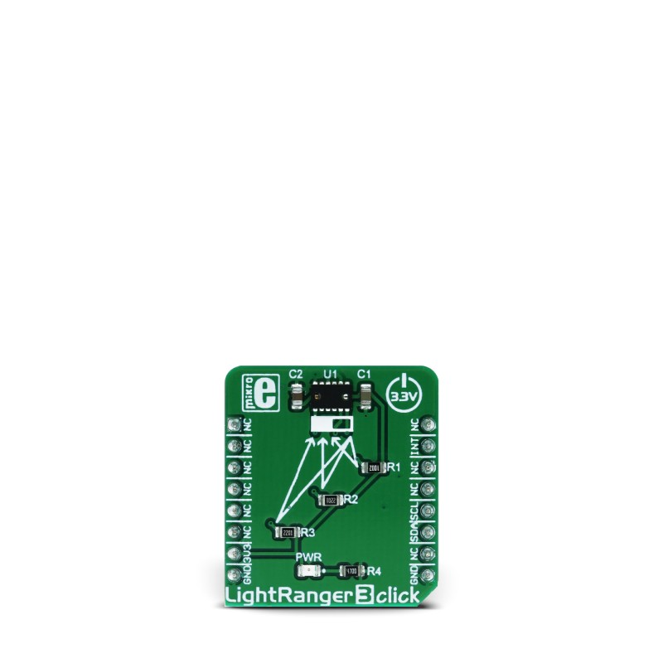
Example of I2C Click Approach
Pull-Up Network

Slide 13
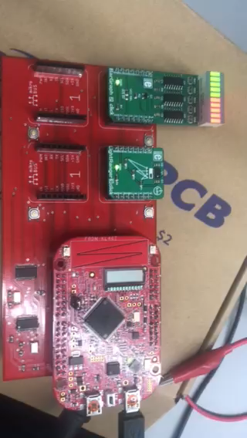
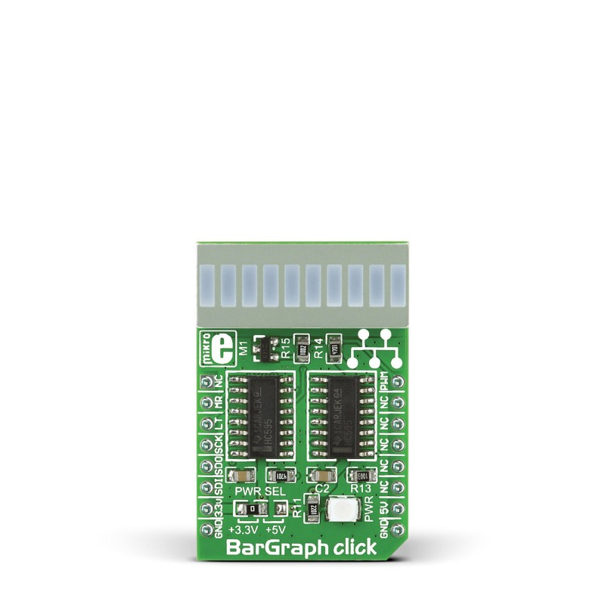
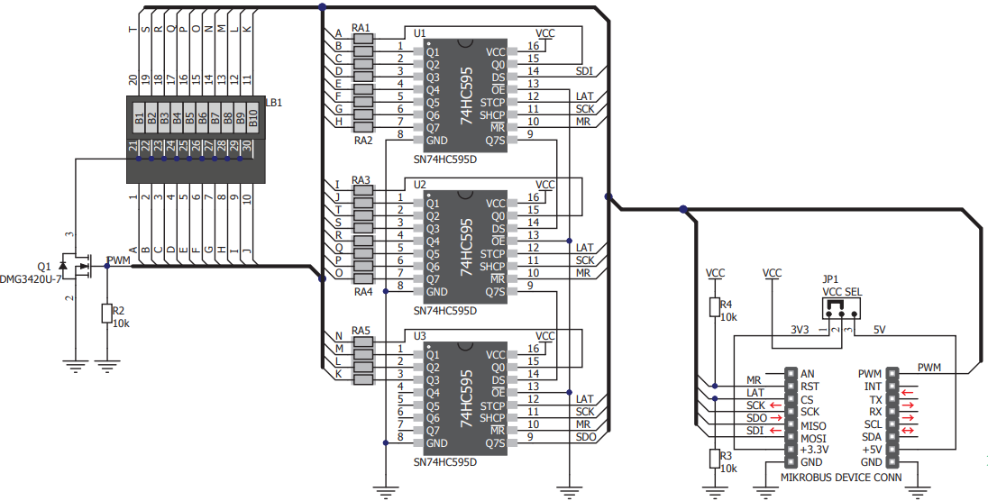
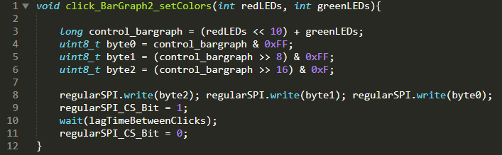
Example of SPI Click Approach

Slide 14
Examples of Click Validation
Test Case | Test Specifications | Test Results | Compliance
Light Ranger 3 Click | Board powered by 3.3V connection | Connected board and checked LED light | Pass
 | Ensure safe connection to FRDM-KL46Z, no feedback voltage should be above 3.3V | Voltages of respective pins measured to be below 3.3V threshold | Pass
 | Get distance readings from Click | Non-zero reading recorded and displayed on PUTTY | Pass
Test Case | Test Specifications | Test Results | Compliance
Bar Graph 2 Click | Board powered by 3.3V and 5V connections | Connected board and checked LED light | Pass
 | Ensure safe connection to FRDM-KL46Z, no feedback voltage should be above 3.3V | Voltages of respective pins measured to be below 3.3V threshold | Pass
 | Cycle Bar Graph Click through set pattern | Pattern set and displayed on Click | Pass
Notes:
PRINT FULL SHEET OF CLICK VALIDATION TEST CASES AND BRING 4 COPIES FOR FDR

Slide 15
Example of Board/Socket Validation
Test Cases | Test Specifications | Test Results | Compliance
Socket #1 |  |  | Passed 5/5
(AN) Analog | Test Analog Click on Socket | Putty output achieved on selected socket with Air Quality Click | Pass
(MISO/MOSI) (CS/SCK) SPI | Test SPI Click on Socket | Bar Graph Click had selected pattern displayed on selected socket | Pass
(RX/TX) UART | Test UART Click on Socket | Serial connection on computer via selected socket | Pass
(SCL/SDA) I2C | Test I2C Click on Socket | I2C connection displayed data on PUTTY terminal using Temp2Hum Click via the selected socket | Pass
PWM | Test PWM Click on Socket | Bar Graph Click had selected pattern displayed on selected socket | Pass
(+3.3V/+5V) VCC/GND | All four mikroBUS™ sockets have both an optional 3.3V and 5V channel. All four mikroBUS™ sockets are grounded | When PCB is powered with 10v and 1amp. Both the +3.3V and +5V channels display proper voltage output. The GND has 0V output | Pass

Slide 16
Final Results
# | Objective | Result of Requirements | Status
1 | Create a board that connects 1 FRDM-KL46Z to 4 MikroBUS standard sockets | All tests passed | Pass
2 | Write necessary code for 10 different Clicks to interact with FRDM-KL46Z via the board created in the first objective | 7/10 tests passed | Partial
3 | Power 4 simultaneous MikroBUS standard sockets via 3.3V and 5V channels provided by a power source that takes 10V/1A | All tests passed | Pass
4 | Create a user guide that details how to implement and make changes to the project | All tests passed | Pass
5 | Stretch Goal – Create cloud hosted website that compiles all the necessary project information in one place. | All tests passed | Pass

Slide 17
Click Results
CLICK NAME | Description and Interface | Interface | Requirement | Status
USB UART 3 click | Adds USB 2.0 functionality | UART | Detect serial connection in PC | Fail
Color 5 click | Integrated color sensing device | I2C | Non-Zero Putty output reading | Fail
BarGraph 2 click | 10-segment bar graph display click, which uses a high-quality, multicolor bar graph LED display | PWM & SPI | Pattern displayed on bar graph | Pass
Accel 5 click | Triaxial accelerometer sensor | I2C & SPI | Non-Zero Putty output reading | Fail
Gaussmeter click | Gaussmeter used for measuring the magnetic field in X, Y and Z axes | I2C & SPI | Non-Zero Putty output reading | Pass
LightRanger 3 click | Accurate distance measurement based on a ToF (Time of Flight) measurement principle | I2C | Non-Zero Putty output reading | Pass
Alcohol click | Portable alcohol detector, breathalyzer for estimating BAC | Analog | Non-Zero Putty output reading | Pass
Air Quality click | detecting a variety of gases that impact air quality in homes and offices | Analog | Non-Zero Putty output reading | Pass
microSD click | A microSD card slot for microSD cards used as a mass storage media for portable devices | SPI | Read SD card file via board | Pass

Slide 18

Acknowledgements

Slide 19
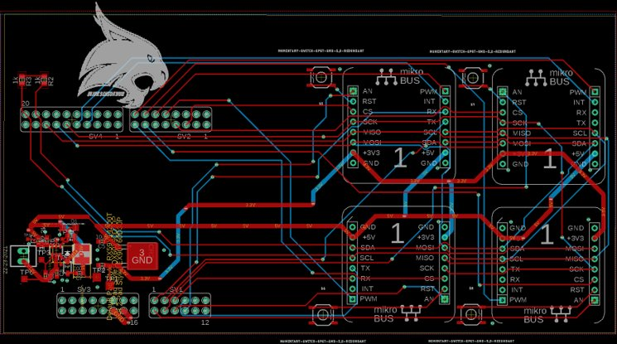

Slide 20
